Slide 1

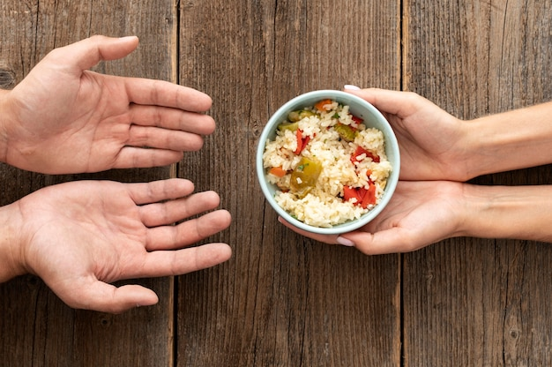

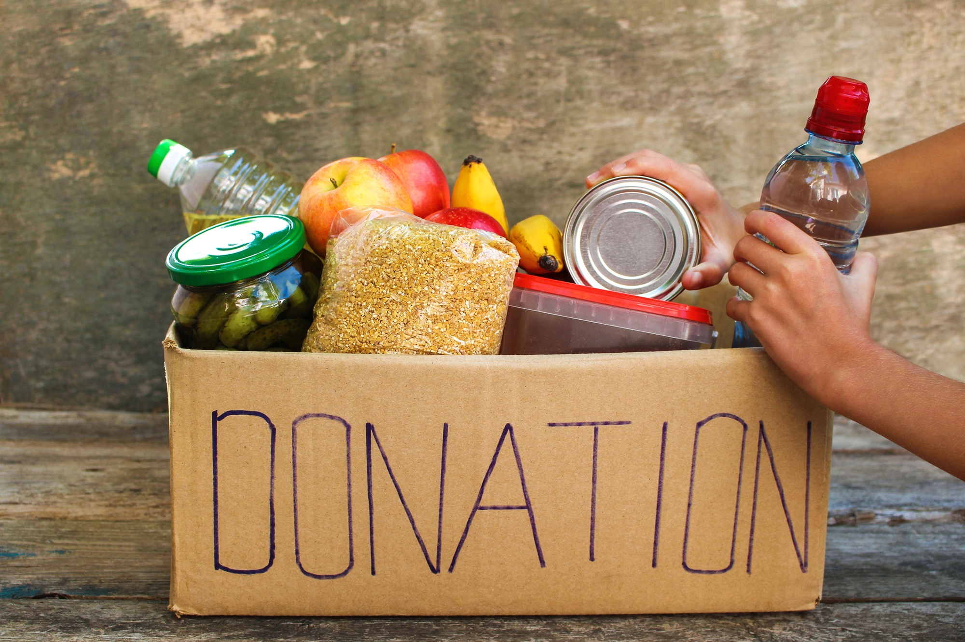
CARE AND SHARE FOOD DONATION WEB APPLICATION
Project Guide- Ms. Neha More
Devang Harsora : S111
Smit Patel : S125
Om Kendre : S136

Slide 2
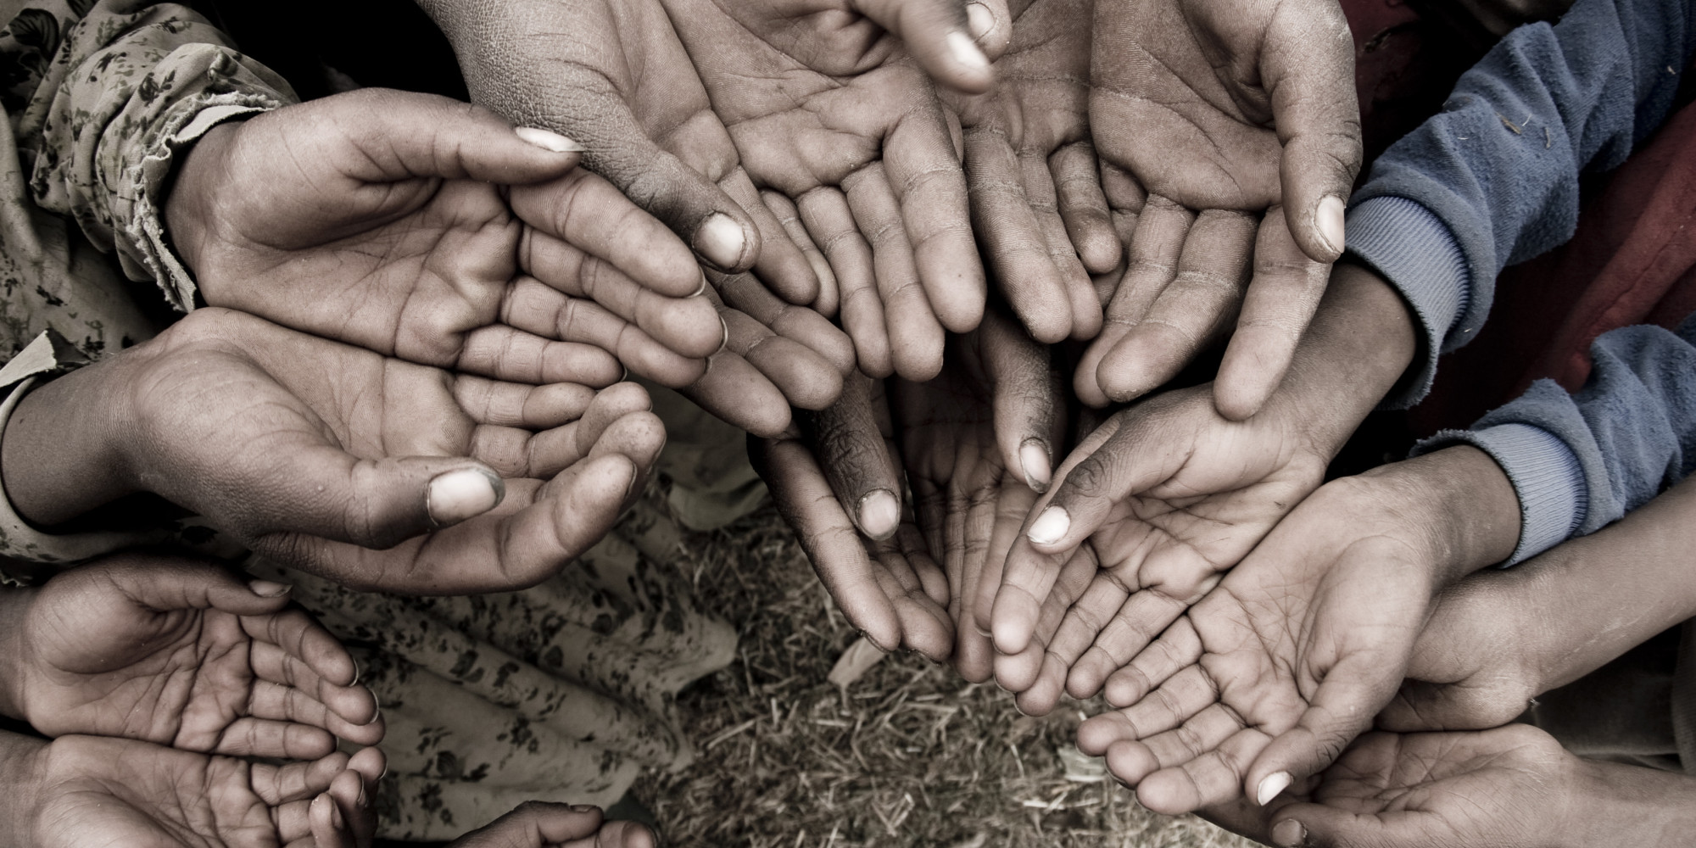
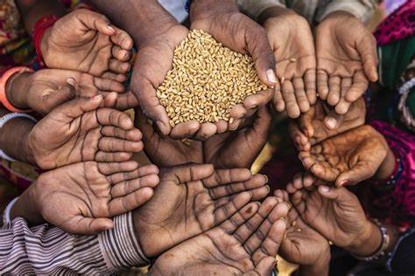
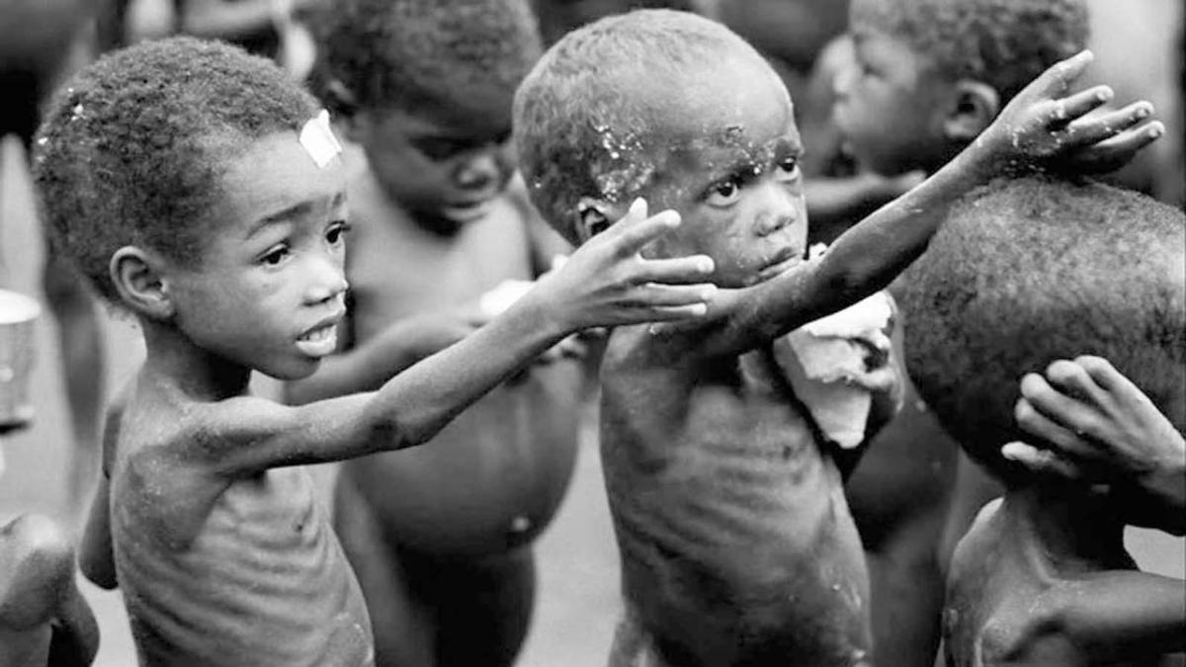
THE CAUSE FOR THE CREATION OF C.A.S.
Food Wastage is a massive problem and one of the most overlooked problems in today’s world.
Most restaurants and cafes have a policy to not serve food from the previous day despite being perfectly edible.
There is more than enough food produced in the world to feed everyone on the planet. Yet as many as 828 million people still go hungry.
This issue became the sole cause of the idea of creation our Project in an attempt to start a fight for eliminating this issue

Slide 3
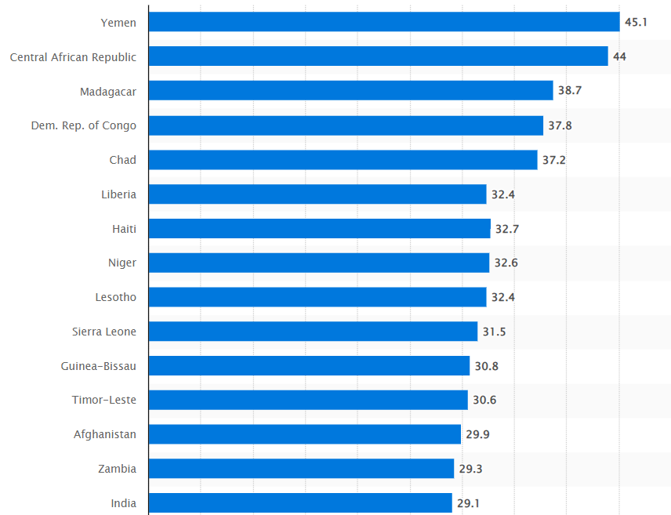
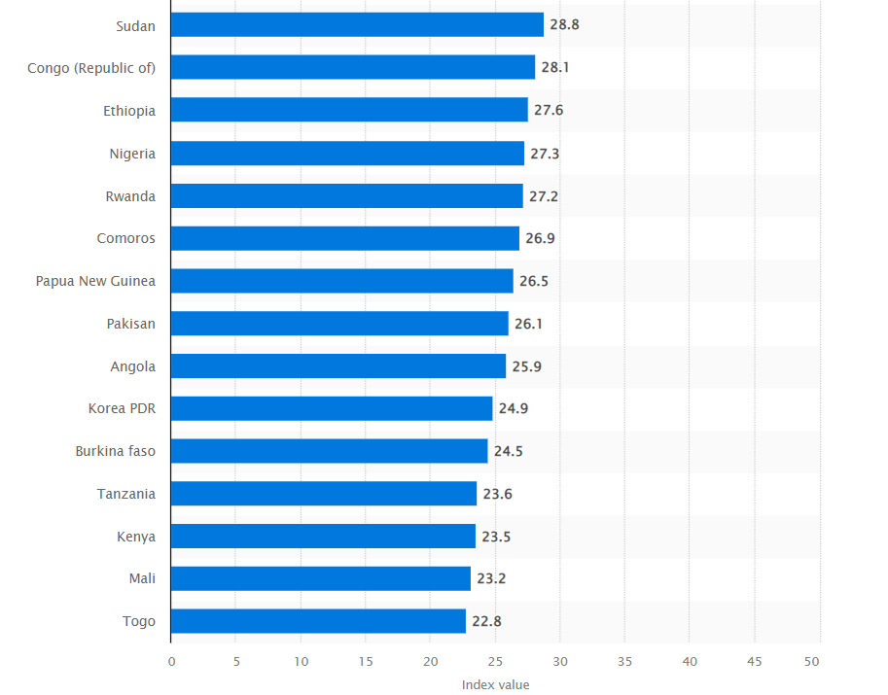
Countries that are most affected by hunger and malnutrition according to the Global Hunger Index 2022
According to the Global Hunger Index 2022, which was adopted by the International Food Policy Research Institute, Yemen was the most affected by hunger and malnutrition, with an index of 45.1. The Central African Republic followed with an index of 44. The World Hunger Index combines three indicators: undernourishment, child underweight, and child mortality.

Slide 4
PROJECT SCOPE OF CARE AND SHARE
A Web Application created using following Implementation Technologies :
Frontend programming: HTML,CSS and Java scripting languages using React J.S. library for creating the frontend.
Backend programming: Spring Boot tool for using Java Programming Language working with Spring Framework.
Database used: MySQL Workbench used for the designing and creation of database.

Slide 5
Spring Boot is used as a (REST API) in our project.
REST is a type of API. Not all APIs are REST, but all REST services are APIs. API is a very broad term. Generally it's how one piece of code talks to another. In web development API often refers to the way in which we retrieve information from an online service.
Project Management: Maven
Maven can appear to be many things, but in a nutshell Maven is an attempt to apply patterns to a project's build infrastructure in order to promote comprehension and productivity by providing a clear path in the use of best practices.
Server: Embedded Tomcat Server.
An embedded Tomcat server consists of a single Java web application along with a full Tomcat server distribution, packaged together and compressed into a single JAR, WAR or ZIP file.

Slide 6
Hardware and Software Requirements (Minimum):
Hardware:
1. Intel i3 processor 3rd generation or later / AMD Ryzen 200 2nd generation or later
2. 2 GB ddr3 ram.
3. Windows 7 Home edition or later.
4. 200 GB Sata HDD Space
5. Data Connection 200 kbps
Software:
Visual Studio Code
MySQL 5.7 with Workbench 8.0
Google Chrome version 79.0
Spring Boot Extension

Slide 7

What exactly is Spring Boot?
Java Spring Framework (Spring Framework) is a popular, open source, enterprise-level framework for creating standalone, production-grade applications that run on the Java Virtual Machine (JVM).
Why have we used Spring Boot?
Primary Cause : While there are several application development options such as firebase, we had a desire to learn more to java with respect to practical application hence we chose to go ahead with Java Spring Boot.
Other Advantages:
Autoconfiguration
Opinionated Approach
Standalone Application

Slide 8
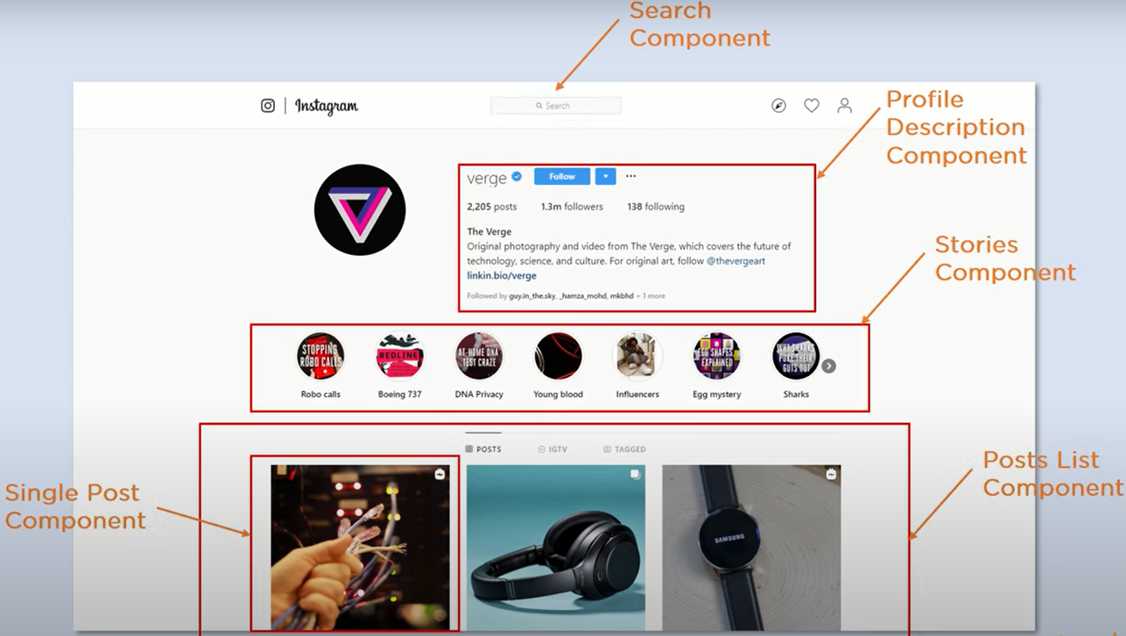
What exactly is React j.s. ?
React j.s. is a JavaScript library for building fast and interactive interfaces.
It is open source, reusable components based front-end library.
Why have we used React j.s.?
Primary cause: Divides the UI into multiple components which makes the code easier to debug and each component has its own property and functions.
Other uses:
• Easy creation of dynamic web apps
• Performance enhancements
• Reusable components
• Unidirectional data flow
• Small learning curve
• Can be used for mobile apps

Slide 9
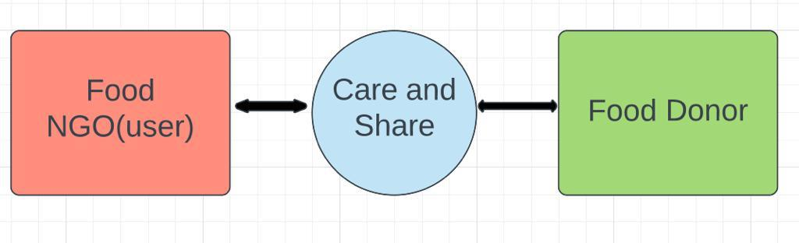
THE OBJECTIVE
Our Project provides a way to bridge the gap between the wastage and deficit, by letting restaurants donate this food to needy like food community, animal care organizations, Food Processing units etc.
Problem statement: To enable the donation and requirement of leftover food likely to be wasted, enable uploading of food details via donors and connect the donors to the concerned customer for distribution of food among the needy.
Nowadays there are some websites and applications available to collect wastage food for specific NGO, our concern is to create a centralized platform of food donation connecting multiple NGOs and multiple restaurants.

Slide 10
THE WORKFLOW
STEP 1
Admin/
Donor adds the product
STEP 4
Successful Delivery of the product
STEP 2
User/NGO opts for the product/
food
STEP 3
Admin notified,
verifies the delivery person

Slide 11
Home Page
Start
About Us
User Module
Login/Register
Contact Us
Admin Enters details
User Enters details
Delivery person Enters details
authentication
authentication
authentication
Add Product, add delivery, Assign order delivery
Add to cart, My Cart and My Products
My Deliveries, Update Delivery Status
Stop

Slide 12
Explaining the working of the Project Modules
User Module:
1)Admin
2)Customer
3)Delivery person
Functional Module:
1) User Authentication--> Login, Register
2) Product Category--> Add Category, View Categories
3) Product--> Add Product, View Products, Search Products by Category
4) Cart--> Add Products to Cart, Remove Products from Cart, View My Cart
5) Order--> Order Products, View all Orders, My Orders, Search Orders by Order ID.
6) Delivery Module--> Assign Delivery Person for the Orders, View My Order Deliveries, Update Delivery Status for the Orders,
View Delivery Status

Slide 13
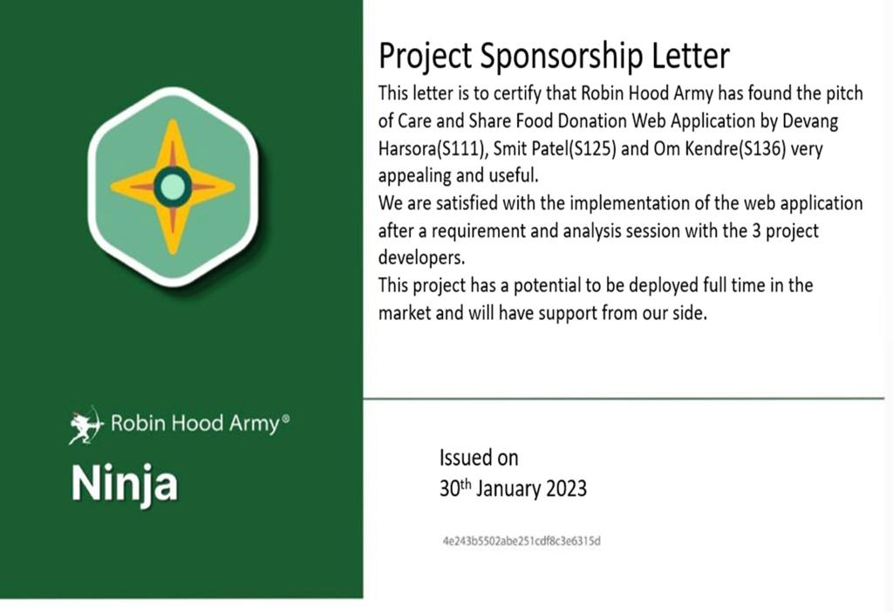
Project Sponsorship Letter
This letter is to certify that Robin Hood Army has found the pitch of Care and Share Food Donation Web Application by Devang Harsora(S111), Smit Patel(S125) and Om Kendre(S136) very appealing and useful.
We are satisfied with the implementation of the web application after a requirement and analysis session with the 3 project developers.
This project has a potential to be deployed full time in the market and will have support from our side.
HI

Slide 14
Future Scope
Delivery Service:
This project has the potential to have its own delivery system with the commission charges and providing direct donor-customer communication.
Mobile Application:
Having a Care and Share mobile application delivered in Play store and IOS app stores will make the use of this idea more convenient and fast for the users.
Notifications System:
The functionality of having a pop-up notification when a donor uploads donated food details onto the web application will increase the pace of the working of the web application.

Slide 15
REFERENCES
1.https://www.youtube.com/watch?v=ER9SspLe4Hg&list=PLu0W_9lII9ahR1blWXxgSlL4y9iQBnLpR
2.https://www.youtube.com/watch?v=729Pd-ZQ4uA&list=PL0zysOflRCelmjxj-g4jLr3WKraSU_e8q
3.https://www.youtube.com/watch?v=jlDFPCGyglo
4.https://www.renderforest.com/blog/website-ideas
5.https://www.geeksforgeeks.org/spring-boot-sending-email-via-smtp/
6.https://www.youtube.com/watch?v=O_XL9oQ1_To

Slide 16
THANK YOU FOR LISTENING TO US, DON’T FORGET TO CARE AND SHARE!

